Slide 1

Jedi 5 Project
Student Management System

Slide 2
Framework for 3 Weeks
Step by step building of project with sufficient emphasis on every stage.
Clear agenda set and completed for every day.
Every day discussion about previous topics and doubt clarifications.
Every day sync up of Project progress.
Hands on assignment of very topic.

Slide 3
Stakeholders
Sponsors
Flipkart
SME’s
SMEs
Other HR and Experts
Trainers
Trainer (Amit Balyan Sir)
Coordinator/ Host (Shakshi)

Slide 4
Agenda
Our Journey
Our Team
Project Goals
Engineering Practices
Tech Stack
Development
Challenges & Learning
Demo
Questions

Slide 5

Our Team
Bhawesh Khandelwal
Sanju Rakonde
Shubham Pagui
Neha Aggarwal
Burrhanuddin Dewaswala
Hitesh Tayal
Amit Balyan Sir (Mentor)

Slide 6
Project Goals
To create an Student Management System, where
Student can
Register for a course
Drop a course
View grades
Professor can
View Course
View list of students he/ she is teaching.
Record grades.
Admin can
Approve user registration.
Assign course to professor.
Add/ Delete user

Slide 7
Engineering Practices
SDLC:
Requirement gathering.
Design
Implementation and coding.
Testing
Deployment
Maintenance

Slide 8
Technology Stack
GIT
Core Java
MySQL
Apache Jersey
Dropwizard

Slide 9
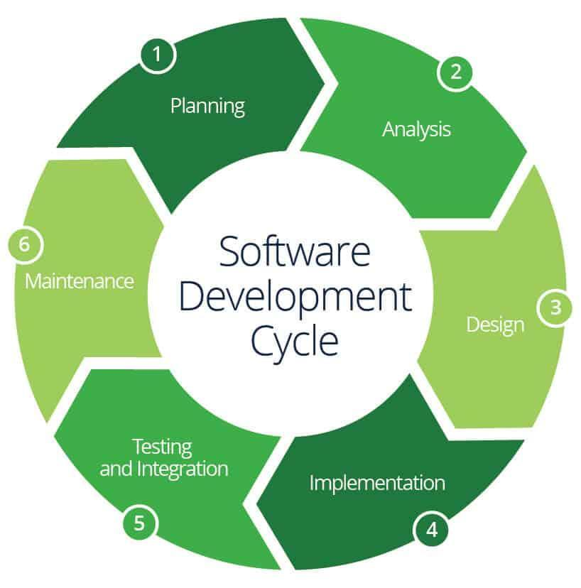
Development

Slide 10

Challenges & Learning

Slide 11
Familiarized with Unix and Git commands.
Learnt about SDLC process.
Learnt handling the issues in setting up the environment.
Learnt JUnit testing and used them in the project.
Learnt the best practices to be followed to make robust as well as scalable projects.
Learnt resolving version conflicts.

Slide 12

Demo

Slide 13

Questions

Slide 14


